Slide 1

Machine Learning and Tableau: Optimising Hotel Bookings
Team
01: Puja Tiwari
02: Rhea Pius
03: Bradley Fisher
04: Sameer Erande

Slide 2
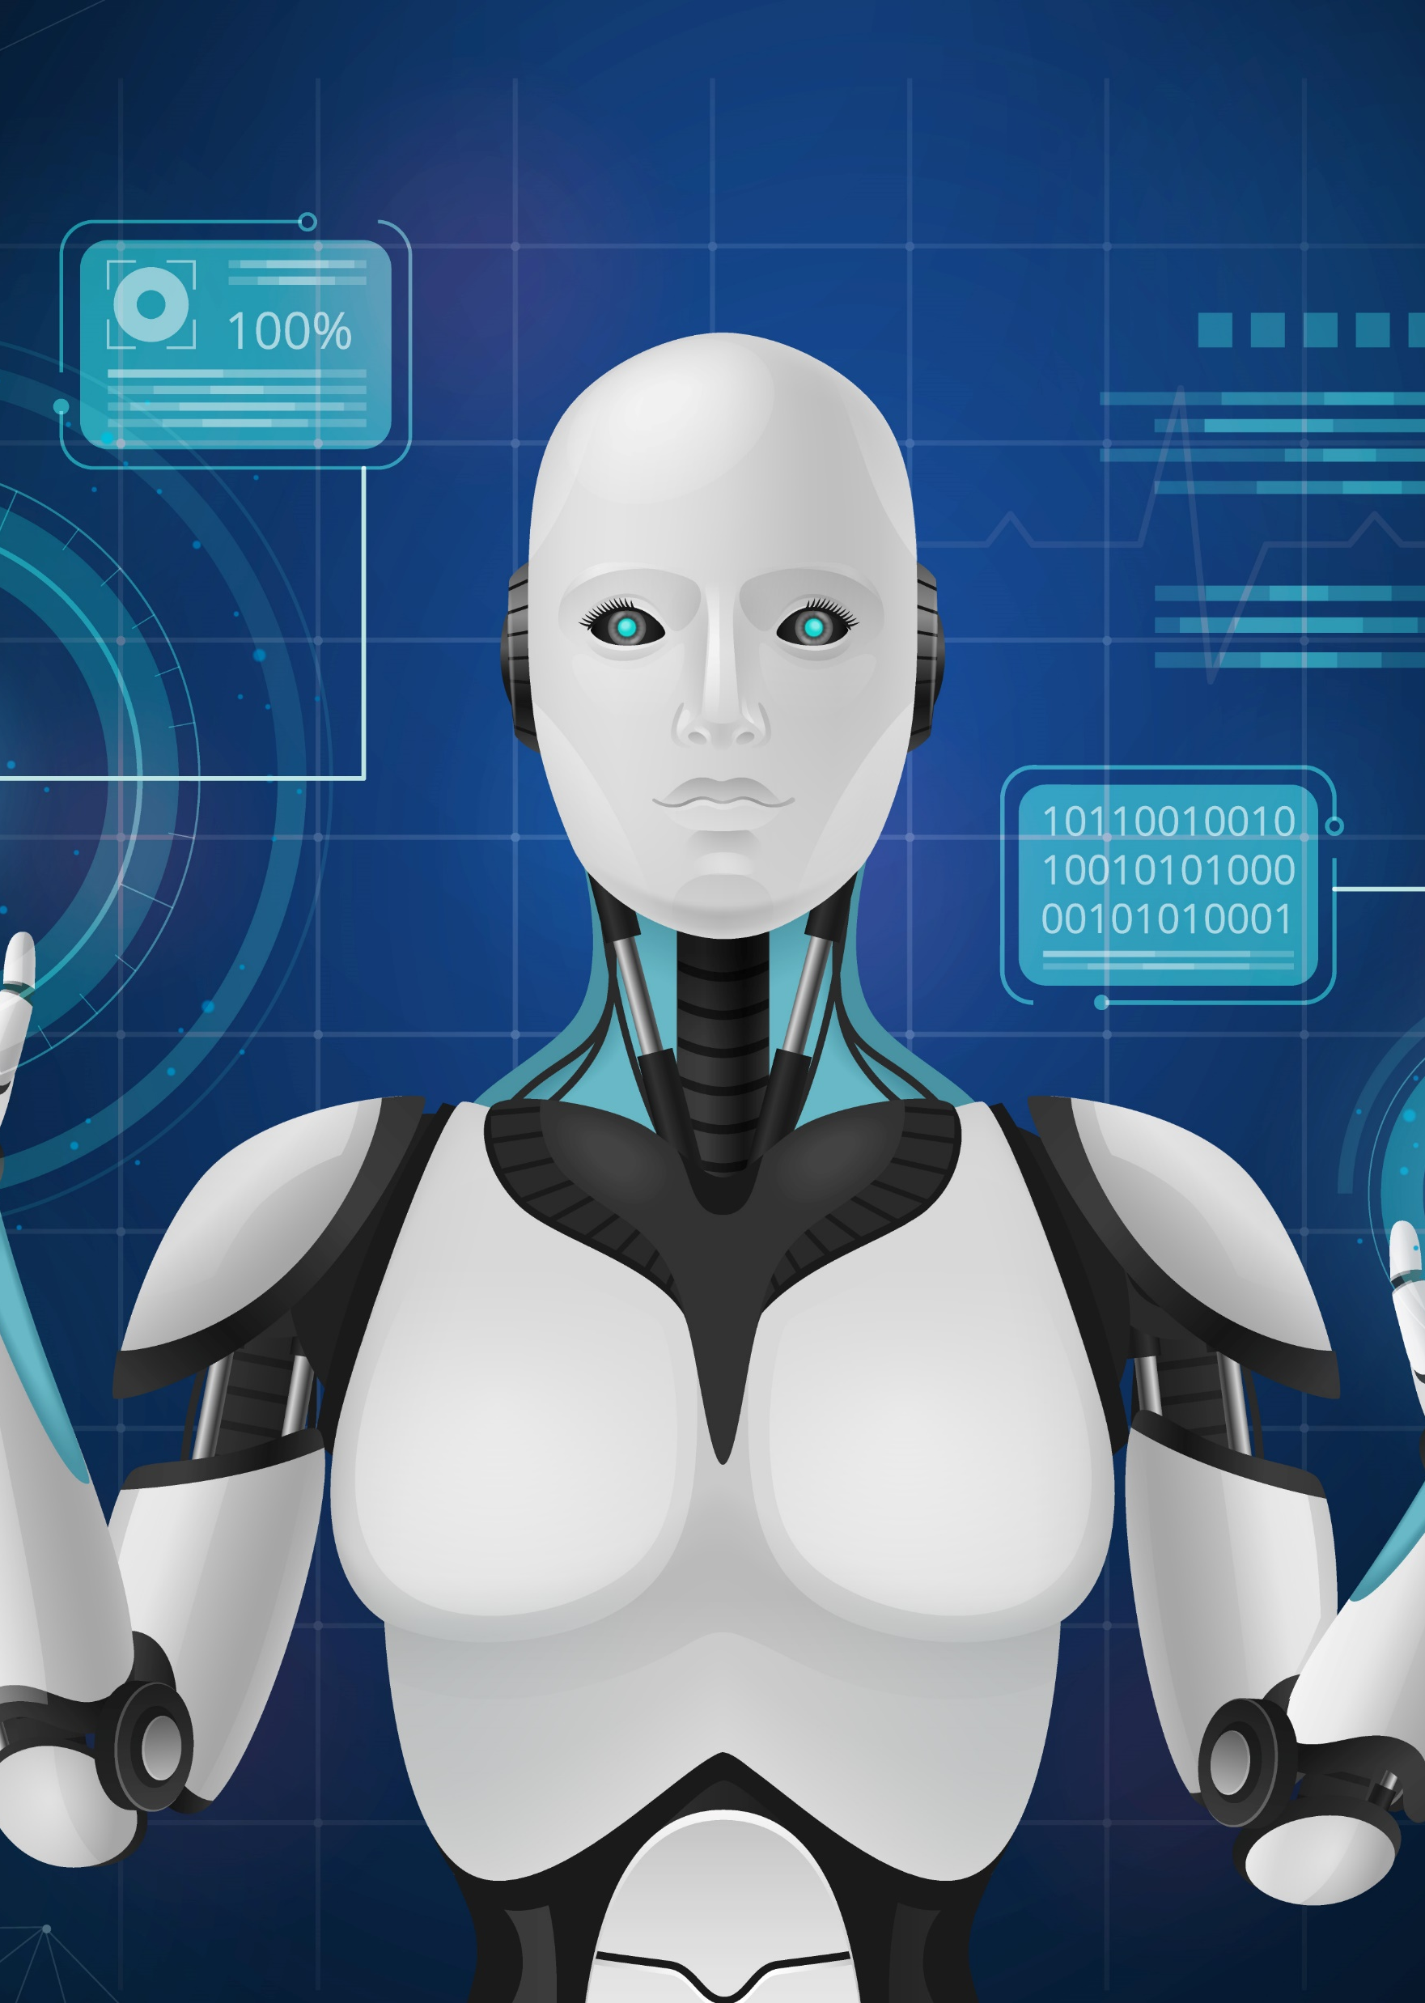
What? Why? How?
01
What? (The problem)
2019, share of direct booking revenue lost due to cancellations had jumped to 15%.
2022, this figure has skyrocketed with 20% of bookings cancelling – a 33% increase over 2019 for the same period.
02
Why? (The insight)
Hoteliers need tools that can help businesses deliver a proactive booking retention game plan.
03
How? (The intelligence)
Build a machine learning (ML) model that can predict features that impact booking outcome

Slide 3





Artificial Intelligence: ML
Data Import
PySpark:
Imports data (csv file)
ML model deployment
TensorFlow/ Logistic Regression/ Random Forest trains and predicts
Data Processing
Python Pandas:
Cleans/ normalises/ standardises the data
ML model evaluation
Loss and accuracy calculations selects final MI model for deployment

Slide 4
Story Telling: Tableau
Top 9 features from ML
Lead_time
avg_price_per_room
arrival_date
no_of_special_requests
arrival_month
market_segment_type
no_of_weekend_nights
arrival_year
Other feature analysis
repeated_guest
no_of_previous_bookings_not_canceled
no_of_previous_cancellations
market_segment_type

Slide 5

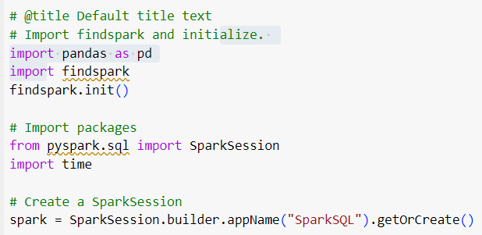
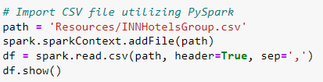


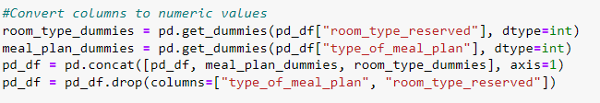
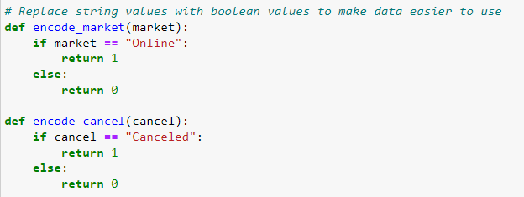
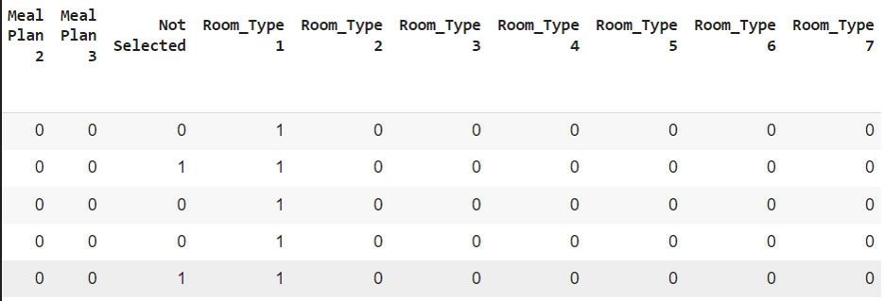

Data processing: PySpark
code
Import csv
dummy variables
Data cleaning
boolean values
Encoding variables

Slide 6
The code

Slide 7
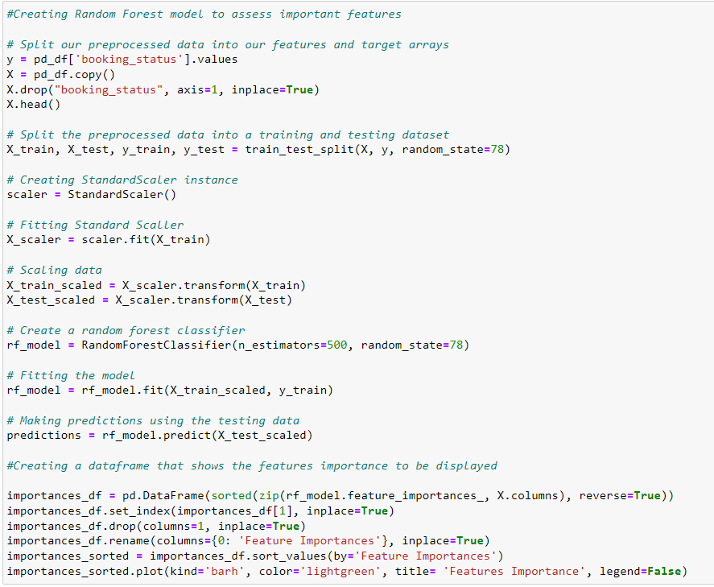
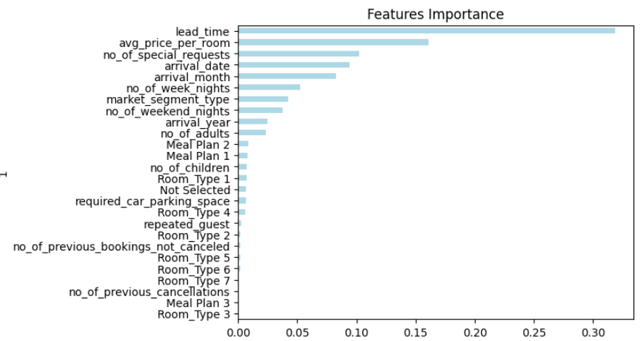
Identifying Features: Random Forest
Top 9 features selected

Slide 8
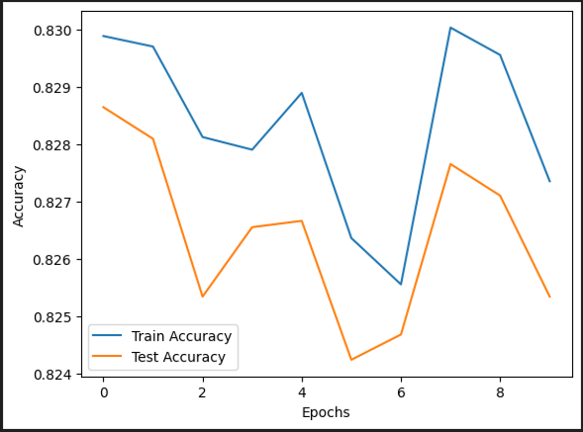
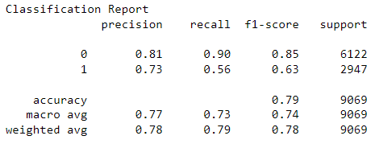
Algorithm Options
TensorFlow
Logistic regression
epochs = 10
Classification Report

Slide 9
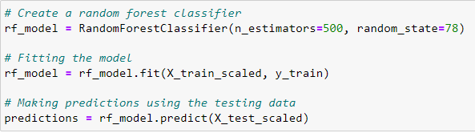
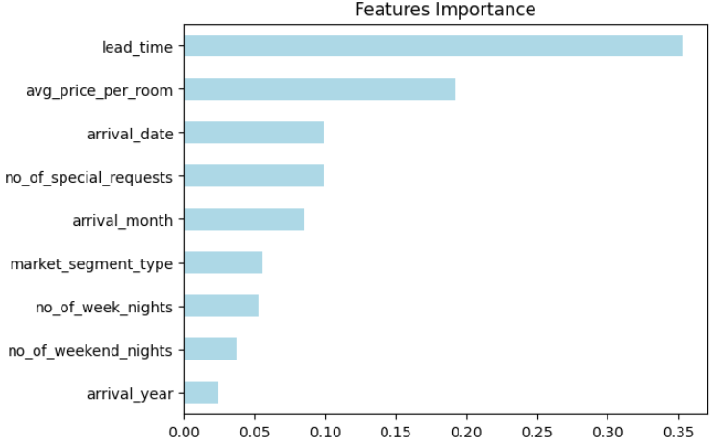
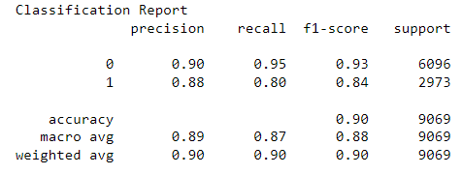
Final ML model deployed: Random Forest
500 trees
Random Forest Classifier
Predictive
Power
Features Importance
Classification Report
Random Forest

Slide 10

Data Analysis: Tableau
Hotel Cancellation Features Analysis

Slide 11







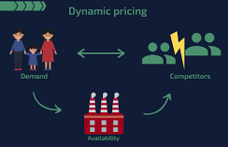
Unlocking Value
Virtual Reality tours
Online bookings are good predictor of an outcome
Marketing thrust on virtual tours will provide further insight to customers and business alike
Chatbots and Virtual Assistants
Booking lead times are top predictor for an outcome
Chatbots and virtual assistants could reduce uncertainty in decision making for longer lead times
Dynamic pricing
Pricing, special requests, customer type play a key role in model predictability
By optimizing pricing strategies, hotels can maximize revenue and reduce the likelihood of cancellations by offering competitive rates

